Slide 1

INVENTORY MODELS
SCHOOL OF DATA SCIENCE AND FORECASTING
DEVI AHILYA VISHWAVIDYALAYA, INDORE

Slide 2
INVENTORY
Inventory is stock of goods held for expected future use, e.g. raw materials, purchased parts, work-in-process, finished goods, spare parts, unfinished goods, etc.
Raw Materials: Purchased but not processed.
Work-In-Process: Undergone some change but not completed.
Maintenance/Repair/Operating (MRO): Necessary to keep machines and processes productive.
Finished Goods: Completed product awaiting shipment.
Inventory Management is used to answer-
How much to order?
When to order?
How much control is appropriate?

Slide 3
FUNCTIONS OF INVENTORY
To meet anticipated demand
To be able to buy or produce in economic lot sizes
To separate stages of operations
To guard against stock-outs
To maintain flexibility in scheduling
To display items in order to accommodate customer selection
To allow for goods in transit (pipeline)

Slide 4
INVENTORY MANAGEMENT-INFORMATION REQUIRED
Demand: Expected demand over a planning horizon.
Lead Time: It includes time to decide how much to order, time to prepare an invoice, time to send the order to the supplier, supplier’s time to prepare, package and ship the order, delivery time, time to unload, time to inspect the order for quantity and quality, etc.
Inventory Costs: 1. Holding (Carrying) Cost 2. Replenishment (Ordering) Cost
3. Purchase Cost 4. Shortage Cost
Quantity on Hand
Objective of Inventory Management:
To minimize the total cost of carrying, ordering, purchasing and shortage costs.
Total Annual Cost = Annual Holding Cost + Annual Ordering Cost + Annual Purchase Cost + Annual Shortage Cost

Slide 5
ECONOMIC ORDER QUANTITY MODELS
Economic Order Quantity (EOQ) models answer the question how much to order.
EOQ Models:
Economic Order Size
Economic Run Size
Economic Order Size with Quantity Discounts
Economic Order Size:
It was introduced in 1915. Now, it is one of the most widely used decision models for independent demand ordering.
Assumptions:
Annual demand is known-through forecast or customers orders.
Item will be withdrawn from inventory at uniform rate.
A constant order size, Q, will be used.
Unit cost is independent of order size-Quantity discounts are not considered.
Orders will be received in their entirely rather than piecemeal.
Replenishment lead times are known and constant.
No shortages will be permitted.

Slide 6
Inventory under EOQ Assumptions
Inventory vs. Time (Replenishment one time)
Q is order quantity = Max. Inventory
Inventory decreases at constant rate as withdrawal from inventory is constant.
Average inventory
= (Min. Inventory + Max. Inventory )/2 = (0+Q)/2 = Q/2
As the lead time and withdrawal are constant the replenishment can easily be timed to coincide with inventory reaches to zero. So that new order immediately restores inventory level to Q units.
Inventory changes w.r.t. Time as sawtooth model.
The objective of EOQ analysis is to find out the order size that will minimize the sum of annual holding and ordering costs. Purchase costs are not included as they are constant regardless of order size. As no shortage is allowed shortage cost is not considered.
Inventory
Q
Receiving entire order
Constant withdrawal rate
Q/2
0
Time

Slide 7
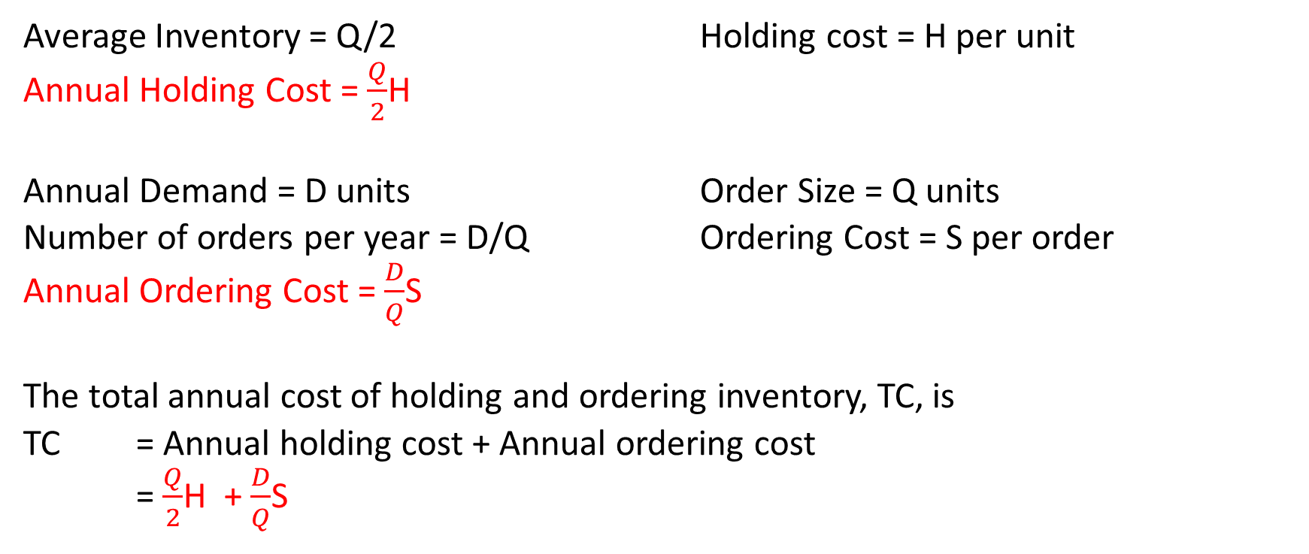
EOQ Model
Average Inventory = Q/2 Holding cost = H per unit
Annual Holding Cost = $\frac{Q}{2}$H
Annual Demand = D units Order Size = Q units
Number of orders per year = D/Q Ordering Cost = S per order
Annual Ordering Cost = $\frac{D}{Q}$S
The total annual cost of holding and ordering inventory, TC, is
TC = Annual holding cost + Annual ordering cost
= $\frac{Q}{2}$H + $\frac{D}{Q}$S

Slide 8
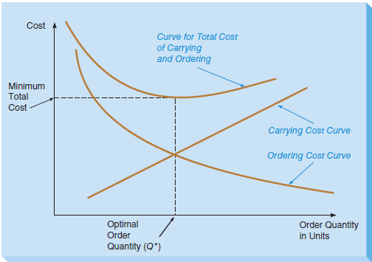
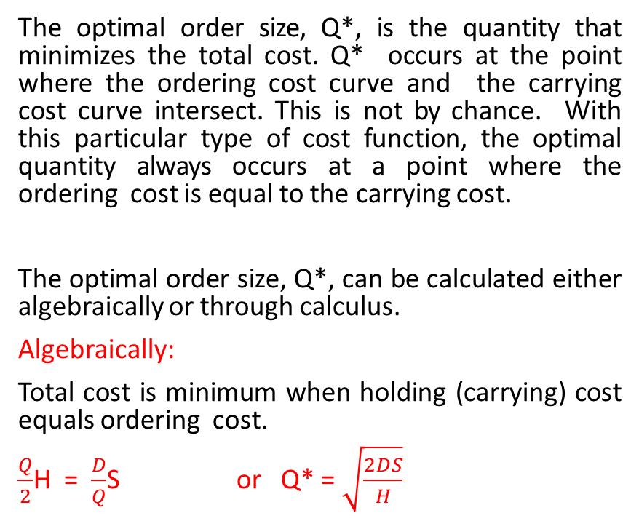
EOQ Model…
The optimal order size, Q*, is the quantity that minimizes the total cost. Q* occurs at the point where the ordering cost curve and the carrying cost curve intersect. This is not by chance. With this particular type of cost function, the optimal quantity always occurs at a point where the ordering cost is equal to the carrying cost.
The optimal order size, Q*, can be calculated either algebraically or through calculus.
Algebraically:
Total cost is minimum when holding (carrying) cost equals ordering cost.
$\frac{Q}{2}$H = $\frac{D}{Q}$S or Q* = $\sqrt{\frac{2DS}{H}}$

Slide 9
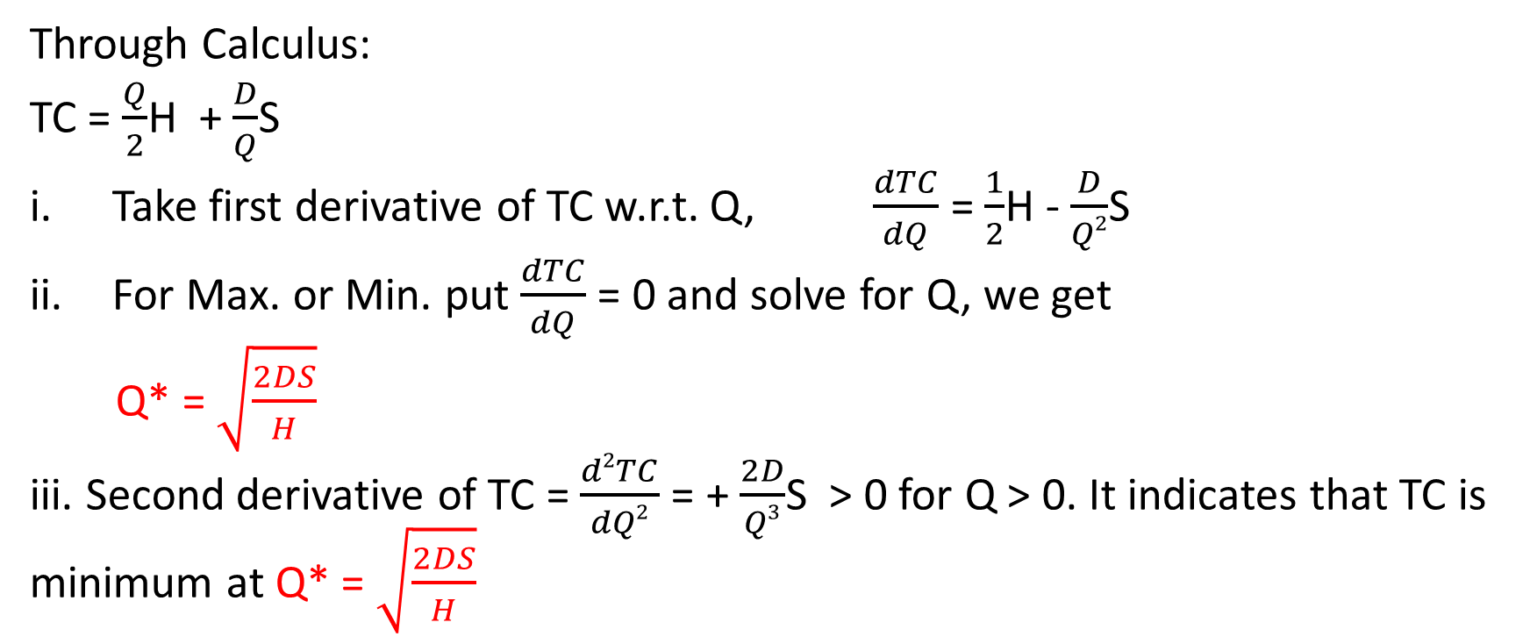
EOQ Model…
Through Calculus:
TC = $\frac{Q}{2}$H + $\frac{D}{Q}$S
Take first derivative of TC w.r.t. Q, $\frac{dTC}{dQ}$ = $\frac{1}{2}$H - $\frac{D}{Q2}$S
For Max. or Min. put $\frac{dTC}{dQ}$ = 0 and solve for Q, we get
Q* = $\sqrt{\frac{2DS}{H}}$
iii. Second derivative of TC = $\frac{d2TC}{dQ2}$ = + $\frac{2D}{Q3}$S > 0 for Q > 0. It indicates that TC is minimum at Q* = $\sqrt{\frac{2DS}{H}}$

Slide 10
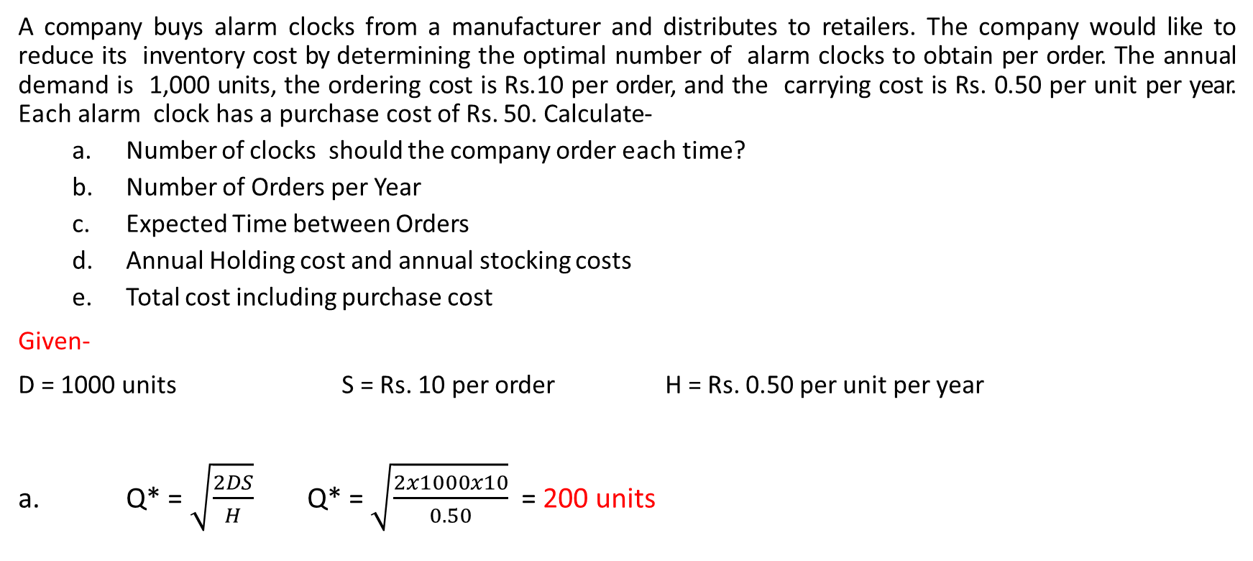
EOQ (Example)
A company buys alarm clocks from a manufacturer and distributes to retailers. The company would like to reduce its inventory cost by determining the optimal number of alarm clocks to obtain per order. The annual demand is 1,000 units, the ordering cost is Rs.10 per order, and the carrying cost is Rs. 0.50 per unit per year. Each alarm clock has a purchase cost of Rs. 50. Calculate-
Number of clocks should the company order each time?
Number of Orders per Year
Expected Time between Orders
Annual Holding cost and annual stocking costs
Total cost including purchase cost
Given-
D = 1000 units S = Rs. 10 per order H = Rs. 0.50 per unit per year
a. Q* = $\sqrt{\frac{2DS}{H}}$ Q* = $\sqrt{\frac{2x1000x10}{0.50}}$ = 200 units

Slide 11
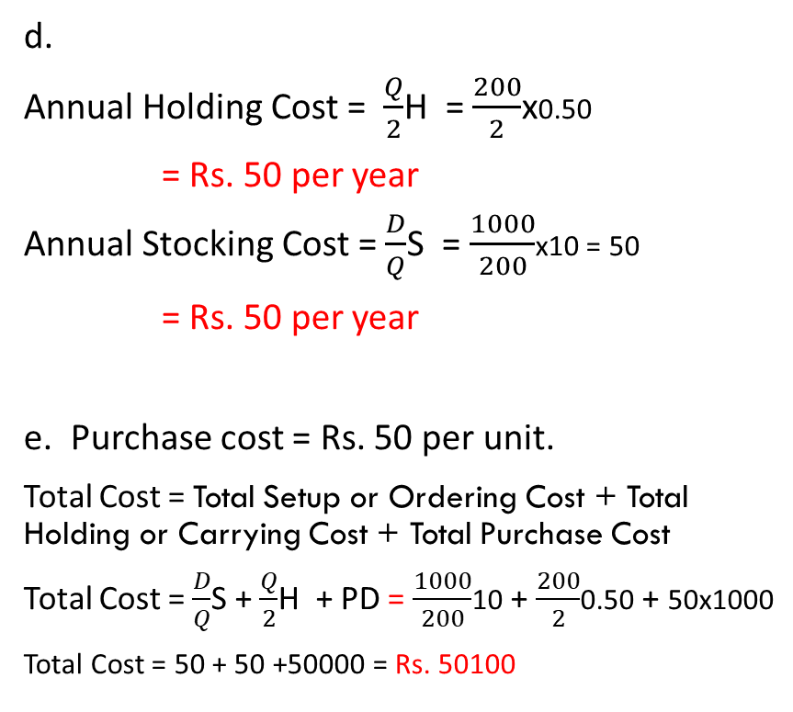
EOQ (Example)….
Number of orders per year = D/Q
= 1000/200 = 5
c. Expected time between orders:
(use information of working days per year in the company, if available. Otherwise, 365 days)
Let us assume there are 250 working days per year.
Expected time between orders = Number of working days per year / number of orders per year.
Expected time between orders = 250 / 5
= 50 days between orders
d.
Annual Holding Cost = $\frac{Q}{2}$H = $\frac{200}{2}$x0.50
= Rs. 50 per year
Annual Stocking Cost = $\frac{D}{Q}$S = $\frac{1000}{200}$x10 = 50
= Rs. 50 per year
e. Purchase cost = Rs. 50 per unit.
Total Cost = Total Setup or Ordering Cost + Total Holding or Carrying Cost + Total Purchase Cost
Total Cost = $\frac{D}{Q}$S + $\frac{Q}{2}$H + PD = $\frac{1000}{200}$10 + $\frac{200}{2}$0.50 + 50x1000
Total Cost = 50 + 50 +50000 = Rs. 50100

Slide 12
Economic Production Run Quantity (Q_{run})
In the first phase, both production and demand take place, with the inventory building rate is equal to the difference between the production and demand rates.
This buildup will continue as long as production continues. When production stops inventory will begin to drop at a rate equal to demand rate. This inventory reduction is the second phase.
Whether goods are ordered or produced, holding costs are there.
Ordering involves ordering cost, production involves setup costs.
Setup cost consists of costs related to preparing the equipment for a production run.
Inventory vs. Time (Replenishment step by step)
Q
Demand only
Production + Demand
Production + Demand
Run size
Cumulative Production
Max. Inventory
Inventory
Inventory
Time

Slide 13
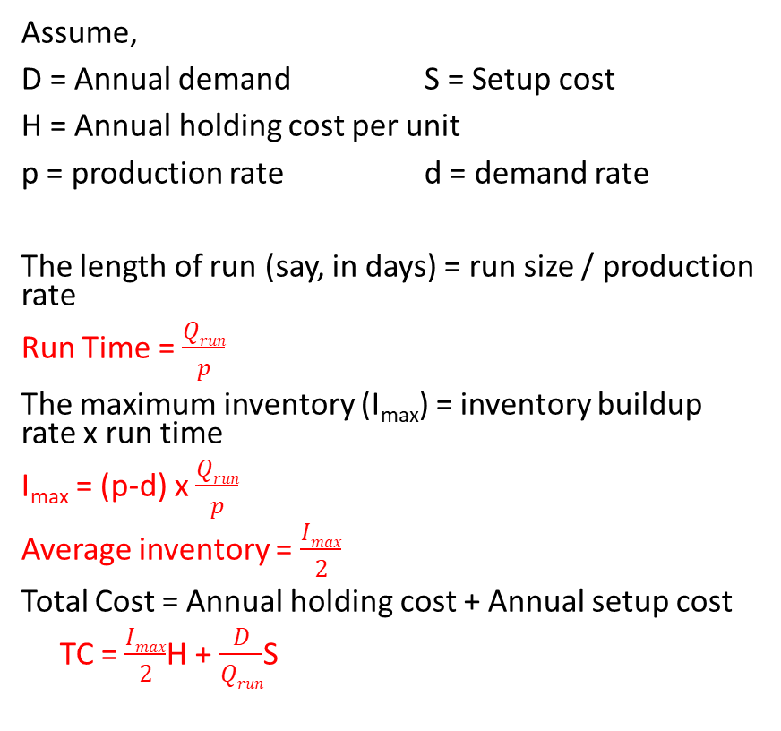
Economic Production Run Quantity (Q_{run})
Assume,
D = Annual demand S = Setup cost
H = Annual holding cost per unit
p = production rate d = demand rate
The length of run (say, in days) = run size / production rate
Run Time = $\frac{Qrun}{p}$
The maximum inventory (I_{max}) = inventory buildup rate x run time
I_{max} = (p-d) x $\frac{Qrun}{p}$
Average inventory = $\frac{Imax}{2}$
Total Cost = Annual holding cost + Annual setup cost
TC = $\frac{Imax}{2}$H + $\frac{D}{Qrun}$S
Inventory vs. Time (Replenishment step by step)
Q
Second Phase
Demand
First Phase
Production + Demand
Production + Demand
Run size
Production rate
Max. Inventory
p
p-d
d
Inventory
Inventory
Time

Slide 14
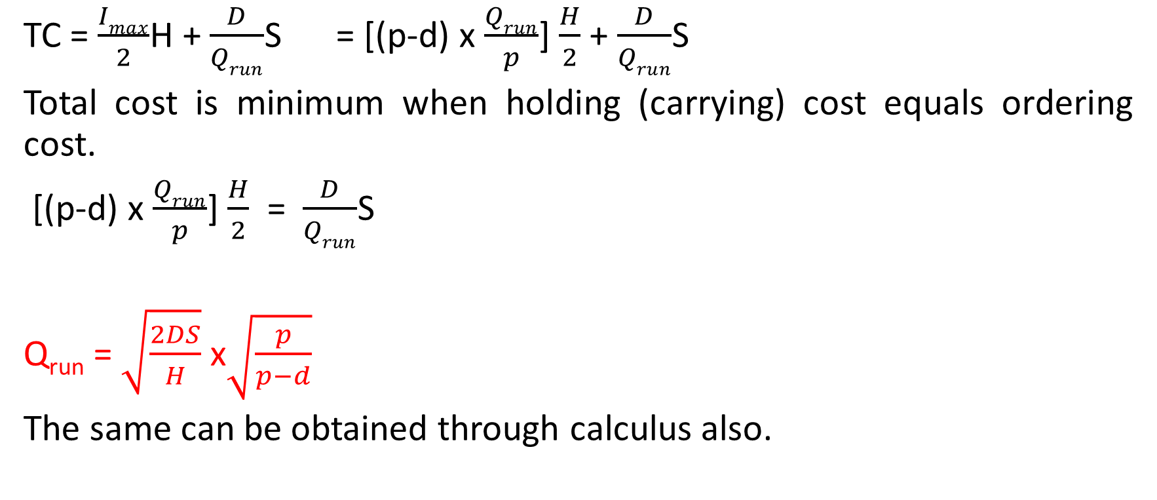
Economic Production Run Quantity (Q_{run})
TC = $\frac{Imax}{2}$H + $\frac{D}{Qrun}$S = [(p-d) x $\frac{Qrun}{p}$] $\frac{H}{2}$ + $\frac{D}{Qrun}$S
Total cost is minimum when holding (carrying) cost equals ordering cost.
[(p-d) x $\frac{Qrun}{p}$] $\frac{H}{2}$ = $\frac{D}{Qrun}$S
Q_{run} = $\sqrt{\frac{2DS}{H}}$ x$\sqrt{\frac{p}{p−d}}$
The same can be obtained through calculus also.

Slide 15
Economic Production Run Quantity (Example)
A company makes and sells a variety of chocolates in a theme park shop. During the summer months, the shop sells an average of 60 kg. of chocolates per day. The chocolates can be produced at a rate of 210 kg. per day. The selling price of chocolates is Rs. 5 per kg. The shop is open seven days per week, and weekly carrying cost is approx. 1% of selling price per kg. Setup cost is Rs. 7.50. Determine the followings:
The optimum run size and the number of runs per week
The maximum amount of chocolates in inventory
The weekly total of holding and setup costs
The length of a production run in days.
Solution:
D = 7 days per week x 60 kg. per day = 420 kg. per week
S = Rs. 7.50 H = 1% of selling price = 1% of Rs. 5 = Rs. 0.05 per kg/week
p = 210 kg. per day d = 60 kg. per day
(Note that both D and H refer to the same time frame)

Slide 16

Economic Production Run Quantity (Example)
Solution:
Q_{run} = $\sqrt{\frac{2DS}{H}}$ x$\sqrt{\frac{p}{p−d}}$ = $\sqrt{\frac{2x420x7.50}{0.05}}$ x$\sqrt{\frac{210}{210−60}}$ = 420 kg.
Hence, there should be one run per week.
b. I_{max} = (p-d) x $\frac{Qrun}{p}$ = (210-60)x420/210 = 300 kg.
c. TC = $\frac{Imax}{2}$H + $\frac{D}{Qrun}$S = $\frac{300}{2}$x0.05 + $\frac{420}{420}$x7.50 = 7.50 + 7.50 = Rs. 15
d. Run Time = $\frac{Qrun}{p}$ = $\frac{420}{210}$ = 2 days.

Slide 17
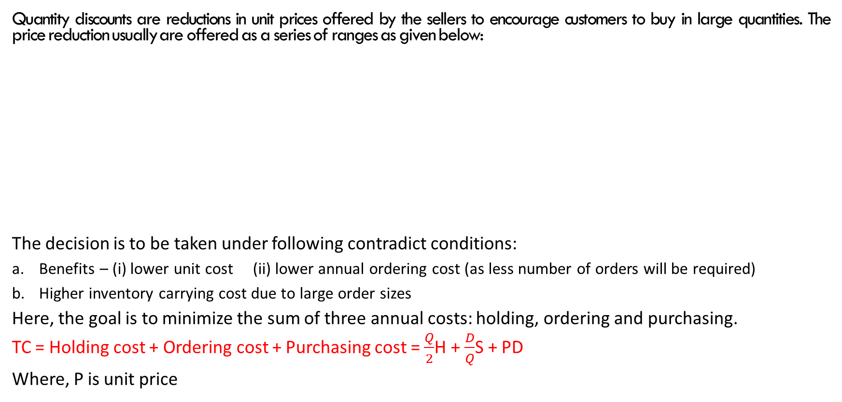
Inventory Models with Quantity Discounts
Quantity discounts are reductions in unit prices offered by the sellers to encourage customers to buy in large quantities. The price reduction usually are offered as a series of ranges as given below:
The decision is to be taken under following contradict conditions:
Benefits – (i) lower unit cost (ii) lower annual ordering cost (as less number of orders will be required)
Higher inventory carrying cost due to large order sizes
Here, the goal is to minimize the sum of three annual costs: holding, ordering and purchasing.
TC = Holding cost + Ordering cost + Purchasing cost = $\frac{Q}{2}$H + $\frac{D}{Q}$S + PD
Where, P is unit price
Order Quantity | Unit Price ($/ Unit)
1 to 119 | 42
120 to 164 | 41
165 or more | 40
Up to certain order quantity unit price remains same and decreases as order size goes beyond that limit.

Slide 18
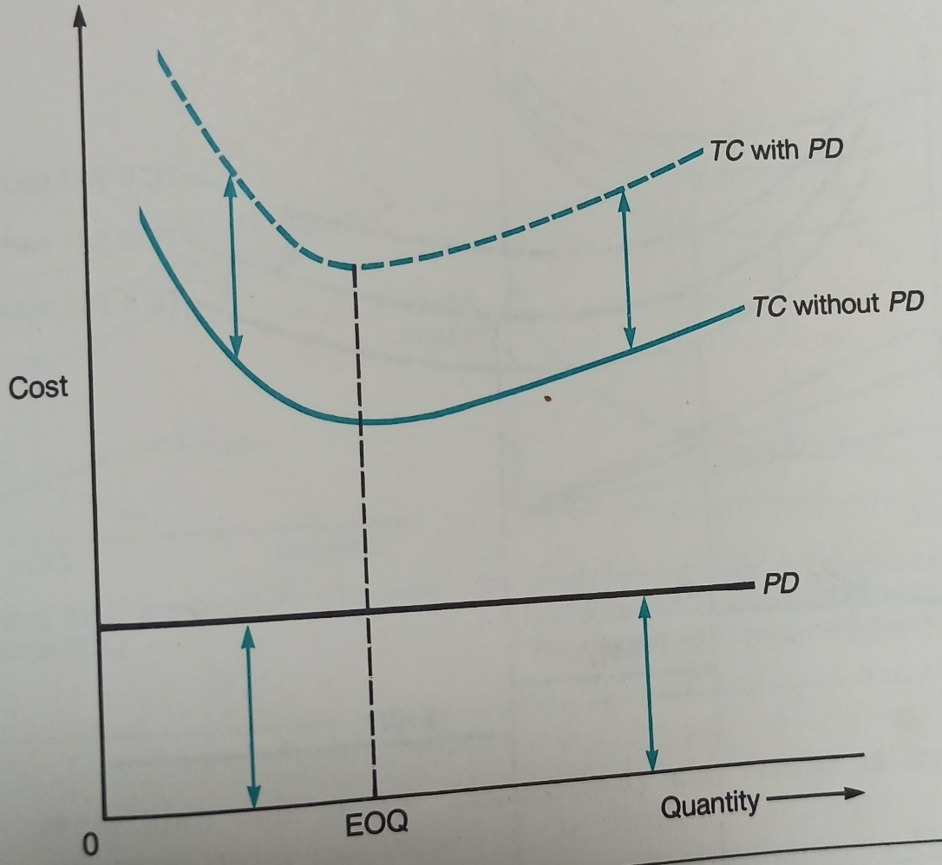
Inventory Models with Quantity Discounts
In case no quantity discounts are available adding purchase cost to the total cost simply increases the total cost by the amount PxD, regardless of order size. In terms of the graph of total cost, adding purchasing cost raises the total cost curve at every point by the same amount. However, neither the shape of the curve nor the quantity at which is reaches its minimum change. This is the reason for not including price in the basic EOQ model.

Slide 19
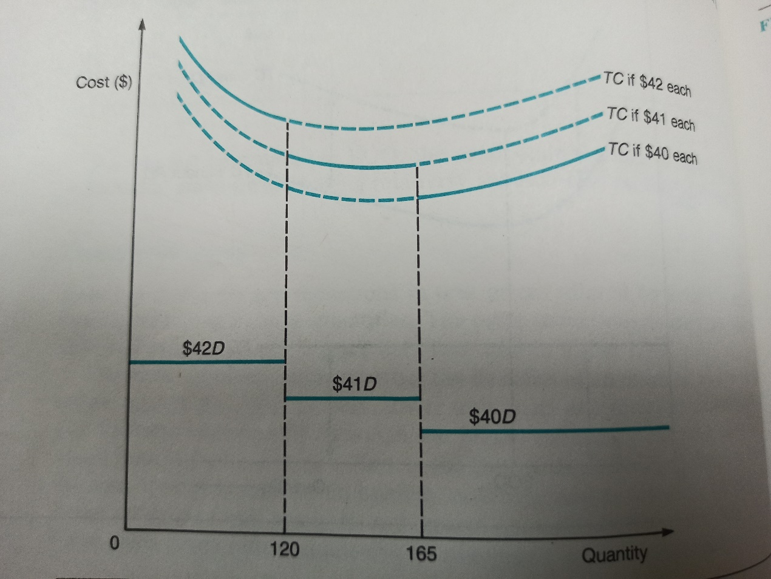
Inventory Models with Quantity Discounts
In case quantity discounts are available, price becomes a real consideration. Adding price to the total cost equation raises the curve at every point by PxD, the amount of increase depends on the size of P. Hence, different prices will raise the curve by different amounts.
Each total cost curve is valid for a range of quantity, represented by solid curve in each curve.
There are two situations to deal with quantity discounts-
Holding cost is constant per unit
Holding cost is related with unit price.

Slide 20

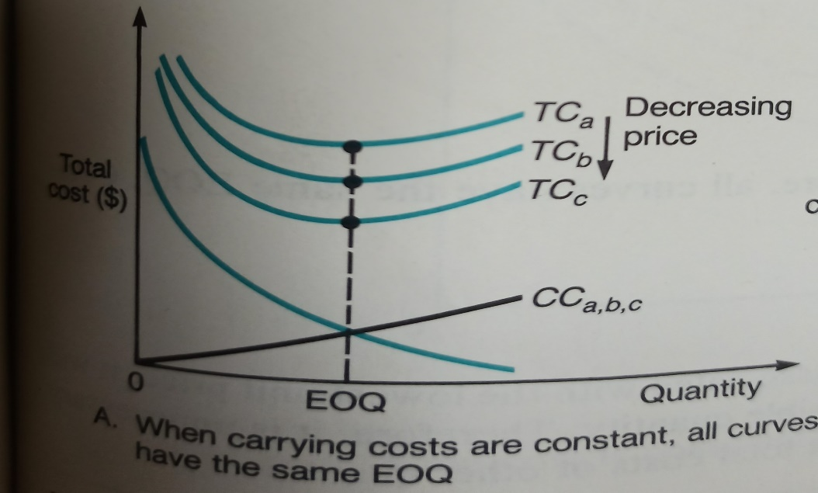
Inventory Models with Quantity Discounts
Holding cost is constant per unit
When holding costs are constant, the various total cost curves corresponding to each unit price will reach their minimum points at the same quantity.
Each total cost curve will have same EOQ, independent of price.
If EOQ is valid for the lowest TC curve, it is global EOQ, no further calculations are required. If the quantity is not valid then we have to check where does it fall and further TC calculations are required to find out optimum EOQ.

Slide 21
Inventory Models with Quantity Discounts
Holding cost is constant per unit:
Procedure to find out optimum EOQ:
Compute the EOQ.
Find which price range it falls in.
If it is large enough to obtain the lowest unit price, it is optimum order quantity. It will minimize total cost.
If it falls in a range associated with a larger unit price, compute the total cost using that price and the total cost for the minimum quantity needed to qualify for a lower unit price. Do this for all lower price breaks.
The quantity (valid EOQ or price break) that produces the lowest total cost is the optimum.

Slide 22
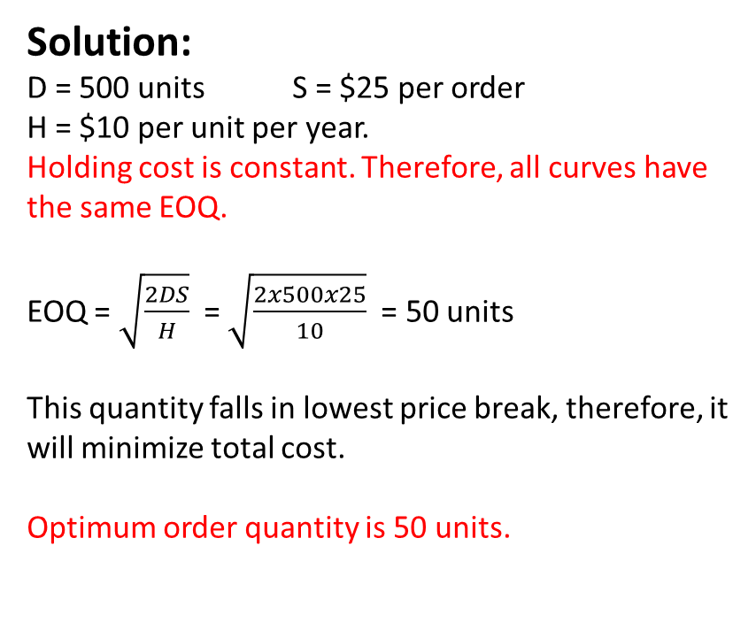
Inventory Models with Quantity Discounts (Example)
Example 1:
Consider the price list given below, determine the order size that will minimize the total of annual holding, ordering and purchasing costs. Annual demand is 500 units, ordering cost is $25, and holding cost is $ 10 per unit per year.
Solution:
D = 500 units S = $25 per order
H = $10 per unit per year.
Holding cost is constant. Therefore, all curves have the same EOQ.
EOQ = $\sqrt{\frac{2DS}{H}}$ = $\sqrt{\frac{2x500x25}{10}}$ = 50 units
This quantity falls in lowest price break, therefore, it will minimize total cost.
Optimum order quantity is 50 units.
Quantity | Unit Price ($)
1 to 20 | 180
21 to 30 | 178
31 to 40 | 175
41 or more | 174

Slide 23
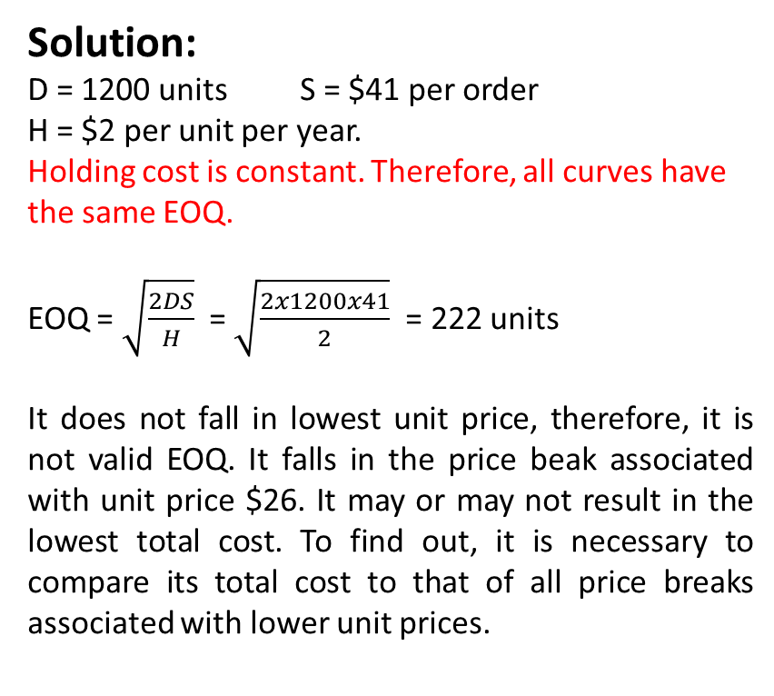
Inventory Models with Quantity Discounts (Example)
Example 2:
Consider the price list given below, determine the order size that will minimize the total of annual holding, ordering and purchasing costs. Annual demand is 1200 units, ordering cost is $41, and holding cost is $ 2 per unit per year.
Solution:
D = 1200 units S = $41 per order
H = $2 per unit per year.
Holding cost is constant. Therefore, all curves have the same EOQ.
EOQ = $\sqrt{\frac{2DS}{H}}$ = $\sqrt{\frac{2x1200x41}{2}}$ = 222 units
It does not fall in lowest unit price, therefore, it is not valid EOQ. It falls in the price beak associated with unit price $26. It may or may not result in the lowest total cost. To find out, it is necessary to compare its total cost to that of all price breaks associated with lower unit prices.
Quantity | Unit Price ($)
1 to 199 | 27
200 to 299 | 26
300 to 399 | 25
400 or more | 24

Slide 24
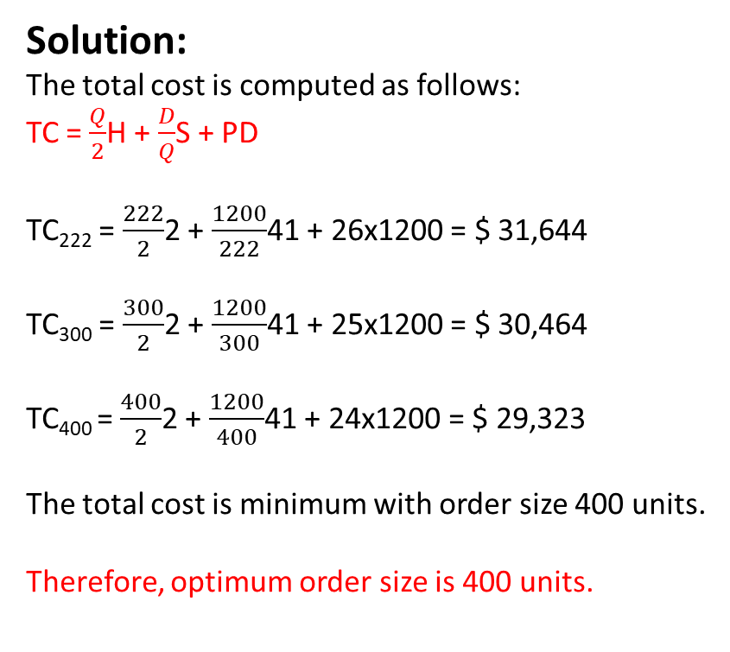
Inventory Models with Quantity Discounts (Example)
Example 2:
Consider the price list given below, determine the order size that will minimize the total of annual holding, ordering and purchasing costs. Annual demand is 1200 units, ordering cost is $41, and holding cost is $ 2 per unit per year.
Solution:
The total cost is computed as follows:
TC = $\frac{Q}{2}$H + $\frac{D}{Q}$S + PD
TC₂₂₂ = $\frac{222}{2}$2 + $\frac{1200}{222}$41 + 26x1200 = $ 31,644
TC₃₀₀ = $\frac{300}{2}$2 + $\frac{1200}{300}$41 + 25x1200 = $ 30,464
TC₄₀₀ = $\frac{400}{2}$2 + $\frac{1200}{400}$41 + 24x1200 = $ 29,323
The total cost is minimum with order size 400 units.
Therefore, optimum order size is 400 units.
Quantity | Unit Price ($)
1 to 199 | 27
200 to 299 | 26
300 to 399 | 25
400 or more | 24

Slide 25
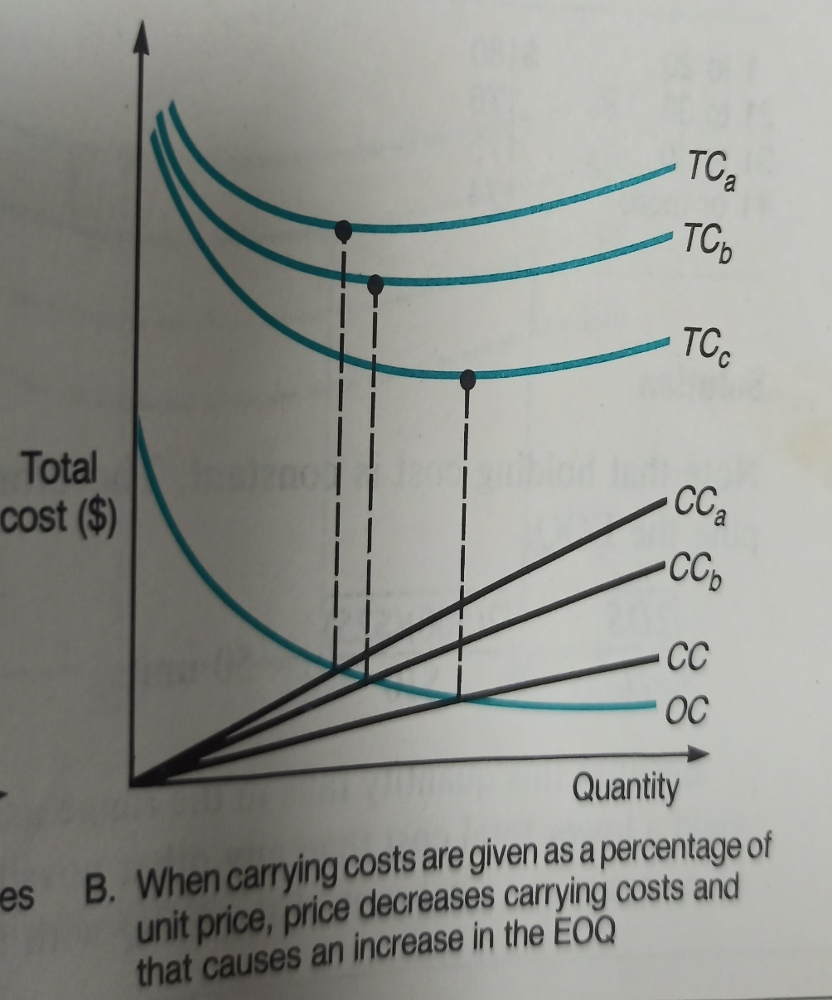
Inventory Models with Quantity Discounts
Holding cost is related with unit price
When holding cost is given as percentage of unit price, the each total cost curve will provide different EOQ. The approach involves finding the lowest TC curve that has a valid EOQ. If it falls in the lowest cost range, it is global EOQ, no further calculations are required. If it is on a higher cost curve, its total cost must be compared to the total costs of all price breaks associated with lower unit prices.
Thus, the procedure is:
Compute the EOQ of each curve, starting with lowest cost curve, until a valid EOQ is found.
If it is on the lowest cost curve, that quantity is optimum.
If it falls in higher cost curve, compare its total cost with that of all price breaks associated with lower unit prices. The one with the lowest total cost is the optimum order quantity.

Slide 26
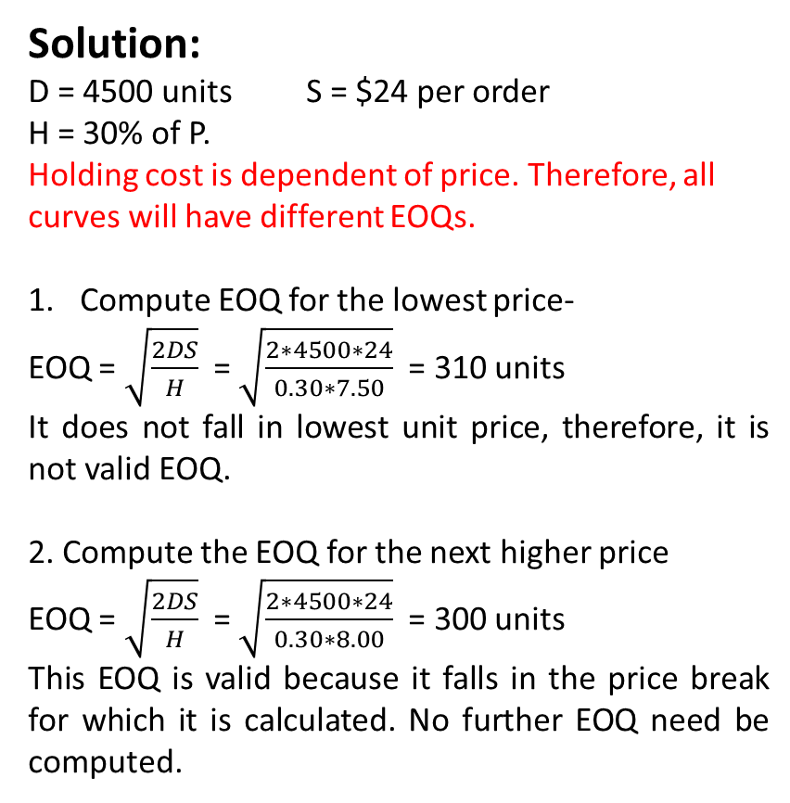
Inventory Models with Quantity Discounts (Example)
Example:
Consider the price list given below, determine the order size that will minimize the total of annual holding, ordering and purchasing costs. Annual demand is 4500 units, ordering cost is $24, and holding cost per unit is 30% of unit price.
Solution:
D = 4500 units S = $24 per order
H = 30% of P.
Holding cost is dependent of price. Therefore, all curves will have different EOQs.
Compute EOQ for the lowest price-
EOQ = $\sqrt{\frac{2DS}{H}}$ = $\sqrt{\frac{2∗4500∗24}{0.30∗7.50}}$ = 310 units
It does not fall in lowest unit price, therefore, it is not valid EOQ.
2. Compute the EOQ for the next higher price
EOQ = $\sqrt{\frac{2DS}{H}}$ = $\sqrt{\frac{2∗4500∗24}{0.30∗8.00}}$ = 300 units
This EOQ is valid because it falls in the price break for which it is calculated. No further EOQ need be computed.
Quantity | Unit Price ($)
1 to 150 | 8.30
151 to 499 | 8.00
500 or more | 7.50

Slide 27
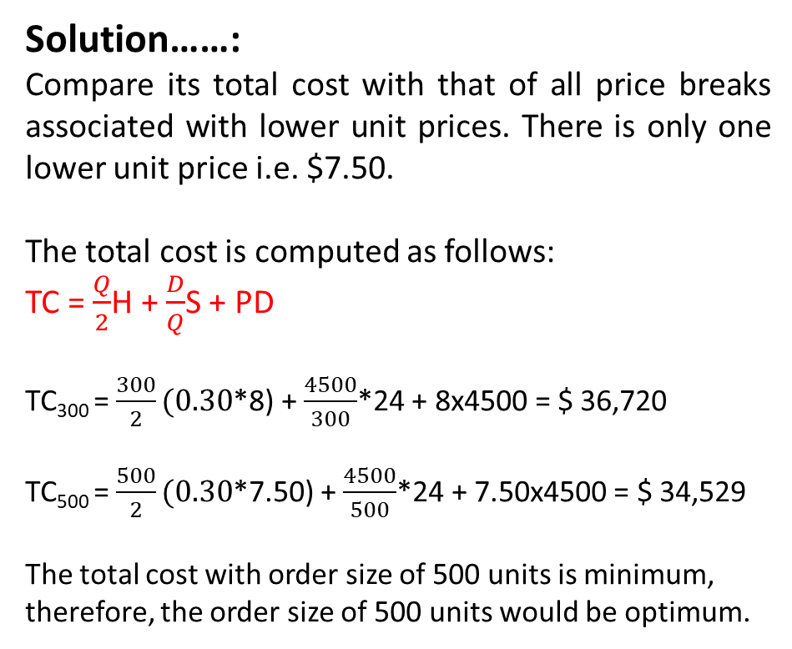
Inventory Models with Quantity Discounts (Example)
Example:
Consider the price list given below, determine the order size that will minimize the total of annual holding, ordering and purchasing costs. Annual demand is 4500 units, ordering cost is $24, and holding cost per unit is 30% of unit price.
Solution……:
Compare its total cost with that of all price breaks associated with lower unit prices. There is only one lower unit price i.e. $7.50.
The total cost is computed as follows:
TC = $\frac{Q}{2}$H + $\frac{D}{Q}$S + PD
TC₃₀₀ = $\frac{300}{2}(0.30$*8) + $\frac{4500}{300}$*24 + 8x4500 = $ 36,720
TC₅₀₀ = $\frac{500}{2}(0.30$*7.50) + $\frac{4500}{500}$*24 + 7.50x4500 = $ 34,529
The total cost with order size of 500 units is minimum, therefore, the order size of 500 units would be optimum.
Quantity | Unit Price ($)
1 to 150 | 8.30
151 to 499 | 8.00
500 or more | 7.50

Slide 28
Reorder Point
A reorder point is a quantity of inventory on hand that triggers for reorder. It is used to answer “When to order?”.
The size of ROP is a function of expected demand during lead time and the extent of variability in lead time demand.
Determination of ROP involves consideration of both expected demand and demand variability as well as the risk of a stock-out that management is willing to tolerate.
If demand and lead time can both be assumed to be constant, the ROP level simply equal to lead-time demand. But, in practice such cases are rare. It is more common to encounter situations in which variability in lead-time demand exists. The presence of variability gives rise potential stock-outs because it is not certain how much inventory will be depleted during the lead time.
Safety Stock:
Safety stock is an additional amount of stock beyond expected demand requirements in order to lessen the possibility of stock-out.
ROP = Expected demand during lead time + safety stock

Slide 29
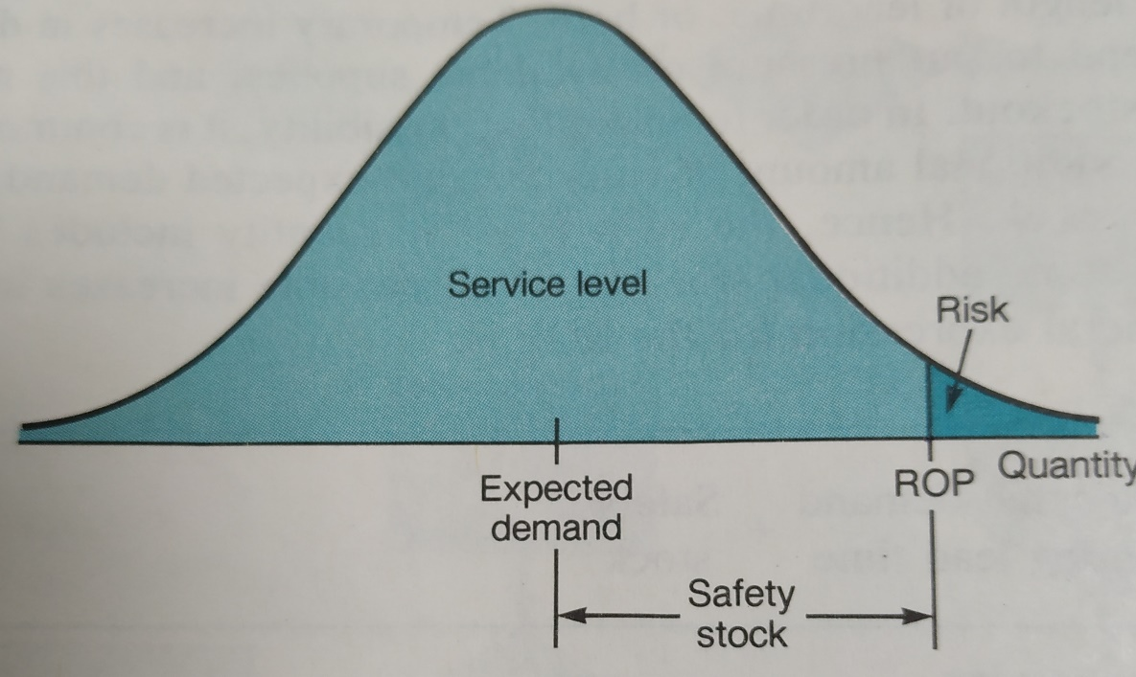
Reorder Point
Although large amounts of safety stock lessen the chance of stock-outs but they add to holding costs. Therefore, a balance between holding and shortage costs is required in establishing a level of safety stock. Assessment of shortage cost is difficult, therefore, the decision makers prefer to set safety stock amounts in terms of a customer service level, which is the probability that a stock-out will not occur (i.e. that demand will not exceed the amount on hand).
A decision maker may decide that a service level of 95% is adequate. This would imply a stock-out risk of 5% (i.e. 1-0.95)
Generally the lead-time demand is described a normal distribution, the service level achieved by a particular ROP is equivalent to the area under the curve to the left of ROP. Risk is area under the curve to the right of ROP. Safety stock is the difference between expected demand and the ROP.

Slide 30
Reorder Point
Computing the Reorder Point:
Know the distribution of lead-time demand and its mean. If it is normal, also know its standard deviation. Let us assume that distribution of lead-time demand is normal. The ROP can be calculated using the formula,
ROP = Expected demand during the lead time + zσ_{dL}
Where, Expected demand = distribution mean
z = number of standard deviations from the mean
σ_{dL} = standard deviation of lead-time demand
The variability of lead-time demand may come solely from demand, with lead time constant; solely from lead time, with demand constant; or from both. Consequently there are three formulas for each variability.

Slide 31
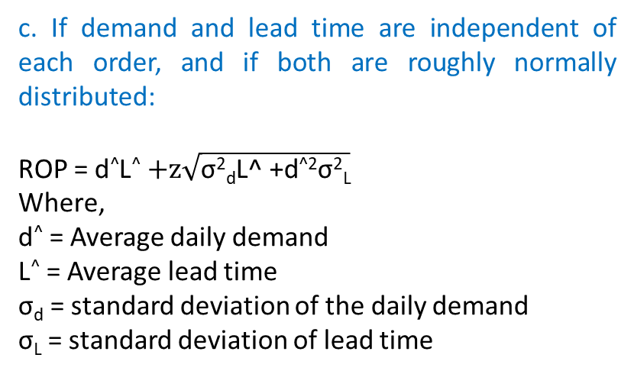
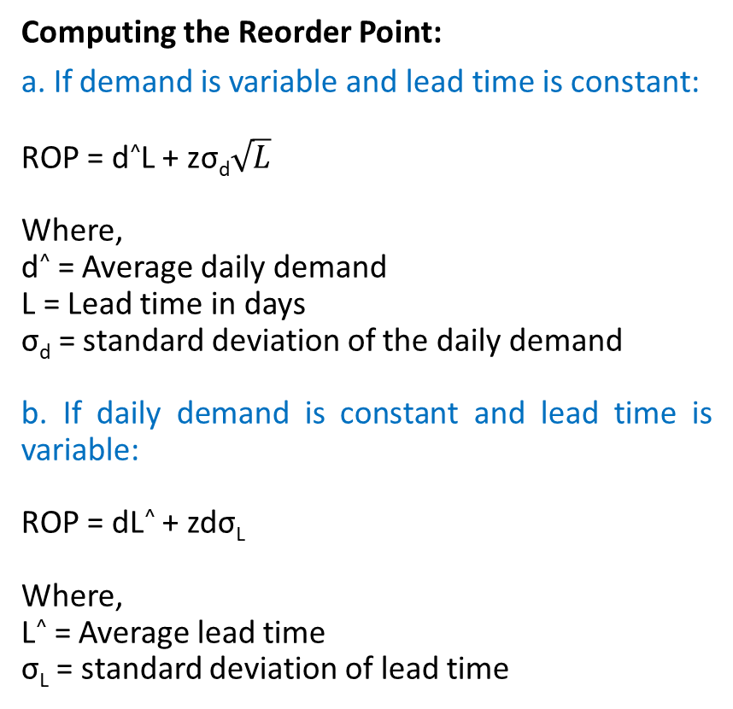
Reorder Point
Computing the Reorder Point:
a. If demand is variable and lead time is constant:
ROP = d^L + zσ_{d}$\sqrt{L}$
Where,
d^ = Average daily demand
L = Lead time in days
σ_{d} = standard deviation of the daily demand
b. If daily demand is constant and lead time is variable:
ROP = dL^ + zdσ_{L}
Where,
L^ = Average lead time
σ_{L} = standard deviation of lead time
c. If demand and lead time are independent of each order, and if both are roughly normally distributed:
ROP = d^L^ $+z\sqrt{\text{σ}\text{2}\text{d}\text{L}\text{^ +}\text{d}\text{^2}\text{σ}\text{2}\text{L}}$
Where,
d^ = Average daily demand
L^ = Average lead time
σ_{d} = standard deviation of the daily demand
σ_{L} = standard deviation of lead time

Slide 32
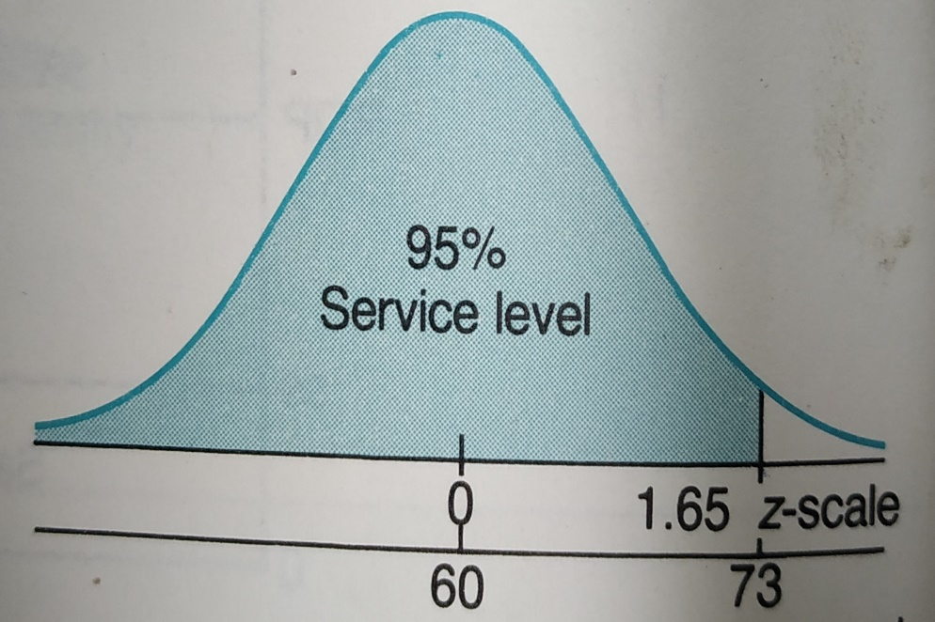
Reorder Point (Example)
For a grocery shop, it is assumed that lead-time demand of rice can be modeled as normal distribution with mean of 60 kg. and standard deviation of 8 kg. What ROP will provide a service level of 95%?
Solution:
Expected demand = 60 kg.
σ_{dL} = 8 kg.
Z = 1.65 (for 95% service level from z table)
ROP = Expected demand during the lead time + zσ_{dL}
= 60 + 1.65x8 = 73.2 or 73 kg. (Take approximate)

Slide 33
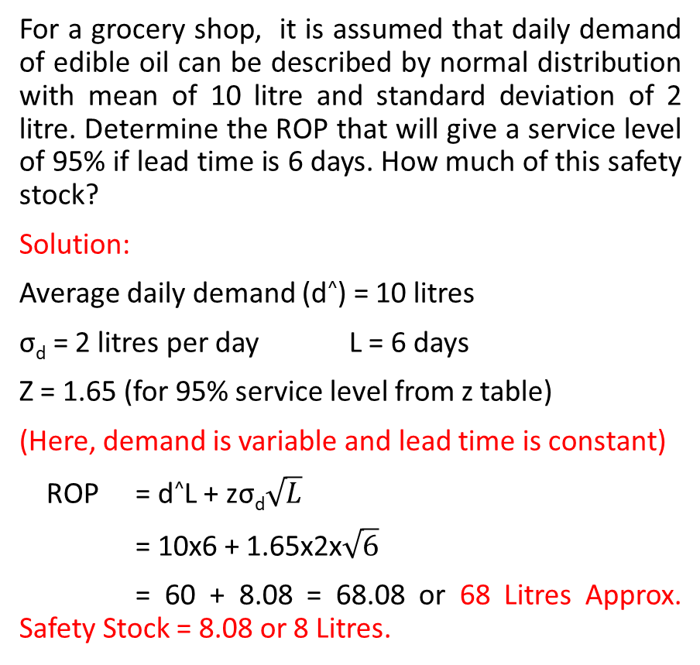
Reorder Point (Example)
For a grocery shop, it is assumed that daily demand of edible oil can be described by normal distribution with mean of 10 litre and standard deviation of 2 litre. Determine the ROP that will give a service level of 95% if lead time is 6 days. How much of this safety stock?
Solution:
Average daily demand (d^) = 10 litres
σ_{d} = 2 litres per day L = 6 days
Z = 1.65 (for 95% service level from z table)
(Here, demand is variable and lead time is constant)
ROP = d^L + zσ_{d}$\sqrt{L}$
= 10x6 + 1.65x2x$\sqrt{6}$
= 60 + 8.08 = 68.08 or 68 Litres Approx. Safety Stock = 8.08 or 8 Litres.
Suppose that daily demand for potato at a shop is 10 Kg. Lead time is variable and can be described by normal distribution with mean of 6 days and standard deviation of 1.5 days. Determine the ROP that will give a service level of 95% .
Solution:
Daily demand = 10 kg.
σ_{L} = 1.5 days L^ = 6 days
Z = 1.65 (for 95% service level from z table)
(Here, demand is constant and lead time is variable)
ROP = dL^ + zdσ_{L}
= 10x6 + 1.65x10x1.5
= 60 + 24.75 = 84.75 or 85 Kg. (Approx.)

Slide 34
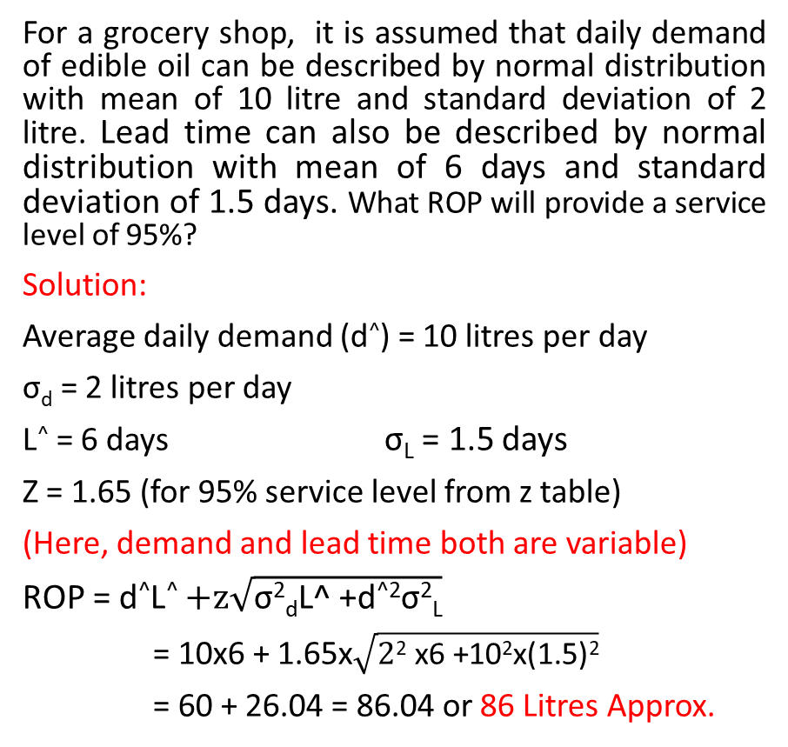
Reorder Point (Example)
For a grocery shop, it is assumed that daily demand of edible oil can be described by normal distribution with mean of 10 litre and standard deviation of 2 litre. Lead time can also be described by normal distribution with mean of 6 days and standard deviation of 1.5 days. What ROP will provide a service level of 95%?
Solution:
Average daily demand (d^) = 10 litres per day
σ_{d} = 2 litres per day
L^ = 6 days σ_{L} = 1.5 days
Z = 1.65 (for 95% service level from z table)
(Here, demand and lead time both are variable)
ROP = d^L^ $+z\sqrt{\text{σ}\text{2}\text{d}\text{L}\text{^ +}\text{d}\text{^2}\text{σ}\text{2}\text{L}}$
= 10x6 + 1.65x$\sqrt{\text{2}\text{2} \text{x}\text{6 +102}\text{x}\text{(1.5)2}}$
= 60 + 26.04 = 86.04 or 86 Litres Approx.
These formulas can also be used to determine the service level (or risk of a stock-out) that a given ROP will provide. In order to do that solve for z and use that value of z to find the service level (from normal distribution table).

Slide 35
A-B-C Analysis (Always Better Control)
ABC analysis is an inventory categorization method. It classify inventory items into three categories A, B, and C according to one or several measures of importance, then allocating control efforts and money on that basis.
A category items are most important, B items are moderately important, and C items are least important.
Often items are classified on the basis of annual monitory value (Unit price x annual volume).

Slide 36
A-B-C Analysis (Always Better Control)
The ABC approach states that a company should rate items from A to C, basing its ratings on the following rules:
A-items are goods which annual monitory value is the highest; the top 70-80% of the annual monitory value of the company typically accounts for only 10-20% of total inventory items.
B-items are the interclass items, with a medium monitory value; those 15-25% of annual monitory value typically accounts for 30% of total inventory items.
C-items are, on the contrary, items with the lowest monitory value; the lower 5% of the annual monitory value typically accounts for 50% of total inventory items.

Slide 37
A-B-C Analysis (Always Better Control)
Steps for the classification of items:
Find out the unit cost and annual requirement of each item;
Calculate annual monitory value of each item-(Monitory value = Annual requirement x unit price);
Arrange all items in the descending order of their annual monitory value;
Accumulate monitory value and add up number of items and calculate percentage on total inventory in monitory value and in number;
Draw a curve of percentage of items and percentage of monitory value;
Mark off from the curve the rational limits of A, B and C categories.

Slide 38
A-B-C Analysis (Always Better Control)
Class of Items | % of Items in number | % of annual monitory value | Control
Class A items | 10%-20% | 60%- 70% | Close day to day control
Class B items | 20%-30% | 10%-25% | Regular review
Class C items | 50% -70% | 5%-10% | Infrequent review

Slide 39
A-B-C Analysis (Always Better Control)
Item number | Unit cost | Annual Demand | Annual Cost
101 | 0.1 | 40,000 | 4000
102 | 1500 | 100 | 150000
103 | 60 | 400 | 24000
104 | 4 | 600 | 2400
105 | 1 | 30,000 | 30000
106 | 3 | 14,000 | 42000
107 | 4.5 | 2000 | 9000
108 | 2.2 | 4000 | 8800
109 | 1.2 | 6000 | 7200
110 | 0.3 | 18000 | 5400
111 | 6 | 28000 | 168000
112 | 5 | 8000 | 40000
113 | 2 | 700 | 1400
114 | 0.7 | 1000 | 700
115 | 0.5 | 800 | 400
116 | 0.2 | 1800 | 360
117 | 0.15 | 2000 | 300
118 | 0.2 | 1000 | 200
119 | 2 | 70 | 140
120 | 0.01 | 13000 | 130
TOTAL |  | 171,470 | 494,430
After sorting as per total cost
Item number | Unit cost | Annual Demand | Annual Cost | % of Annual Cost to Total Cost | % of Annual Demand to Total Demand
111 | 6 | 28000 | 168000 | 33.98% | 16.33%
102 | 1500 | 100 | 150000 | 30.34% | 0.06%
106 | 3 | 14,000 | 42000 | 8.49% | 8.16%
112 | 5 | 8000 | 40000 | 8.09% | 4.67%
105 | 1 | 30,000 | 30000 | 6.07% | 17.50%
103 | 60 | 400 | 24000 | 4.85% | 0.23%
107 | 4.5 | 2000 | 9000 | 1.82% | 1.17%
108 | 2.2 | 4000 | 8800 | 1.78% | 2.33%
109 | 1.2 | 6000 | 7200 | 1.46% | 3.50%
110 | 0.3 | 18000 | 5400 | 1.09% | 10.50%
101 | 0.1 | 40,000 | 4000 | 0.81% | 23.33%
104 | 4 | 600 | 2400 | 0.49% | 0.35%
113 | 2 | 700 | 1400 | 0.28% | 0.41%
114 | 0.7 | 1000 | 700 | 0.14% | 0.58%
115 | 0.5 | 800 | 400 | 0.08% | 0.47%
116 | 0.2 | 1800 | 360 | 0.07% | 1.05%
117 | 0.15 | 2000 | 300 | 0.06% | 1.17%
118 | 0.2 | 1000 | 200 | 0.04% | 0.58%
119 | 2 | 70 | 140 | 0.03% | 0.04%
120 | 0.01 | 13000 | 130 | 0.03% | 7.58%
TOTAL |  | 171,470 | 494,430 | 100.00% | 100.00%

Slide 40
A-B-C Analysis (Always Better Control)
Classification:
Class | Items | % of Items | % of Monitory Value | Action
A | 111, 102 | 16.39% | 64.32% | Close control
B | 106,112,105, 103 | 30.56% | 27.50% | Regular review
C | 107,108,109,110,101,104,113,114,115,116,117,118,119,120 | 53.05% | 8.18% | Infrequent review

Slide 41
Inventory Management Policies
Each item should be treated as per its class:
A-items should have tight inventory control, more secured storage areas and better sales forecasts; reorders should be frequent, with weekly or even daily reorder; avoiding stock-outs on A-items is a priority.
B-items need regular review. Their status lies between A and C; an important aspect of class B is the monitoring of potential evolution toward class A or, in the contrary, toward the class C.
C-items do not need regular review. Reordering of C-items is made less frequently and can be purchased in bulk using discounts. C-items present high demand and lower risk of excessive inventory costs.

Slide 42
Thank You!
Dr. V.B.Gupta
+ 91 99933 50547
vbgupta.davv@gmail.com

